Slide 1

Movie Recommendation System
Courtney David
Audience: Non Technical.

Slide 2
What is a recommendation system?
Recommender systems are the systems that are designed to recommend things to the user based on many different factors.
These systems predict the most likely product that the users are most likely to purchase and are of interest to.
Companies like Netflix, Amazon, etc. use recommender systems to help their users to identify the correct product or movies for them.

Slide 3
Why use recommendation systems?
Benefits users in finding items of their interest.
Help item providers in delivering their items to the right user.
Identity products that are most relevant to users.
Personalized content.
Help websites to improve user engagement.

Slide 4
Types of recommendation systems
Demographic Filtering
Content-based Filtering
Collaboration-based Filtering
The recommendations are the same for every user. They are generalised, not personalised. These types of systems are behind sections like “Top Trending”.
These suggest recommendations based on the item metadata (movie, product, song, etc.). Here, the main idea is that if a user likes an item, they will also like items like it.
These systems make recommendations by grouping users with similar interests. For this system, metadata of the item is not required.

Slide 5
My Project: Context of the Project
Everyone loves movies irrespective of age, gender, race, colour, or geographical location. We all are connected via this fantastic medium. Yet what is most interesting is how unique our choices and combinations are regarding movie preferences.
Recommendation systems also learn your viewing patterns and may suggest content based on the time of the day or your watching patterns.
The recommender system helps users quickly find their preferred movies without searching from the extended content catalogue. From a business perspective, the more relevant content, or movies a user finds on any platform, the higher their engagement and, as a result, increased revenue.

Slide 6




Problem Statement
How can data from a movie-based platform recommend other movies to users based on their preferences and activities on that platform?

Slide 7
My Project: Movie Recommendation system
I built a content-based and demographic recommendation engine for movies. The approach to building the movie recommendation engine consists of the following steps.
Perform Exploratory Data Analysis (EDA) on the data
Build the recommendation system
Get recommendations

Slide 8
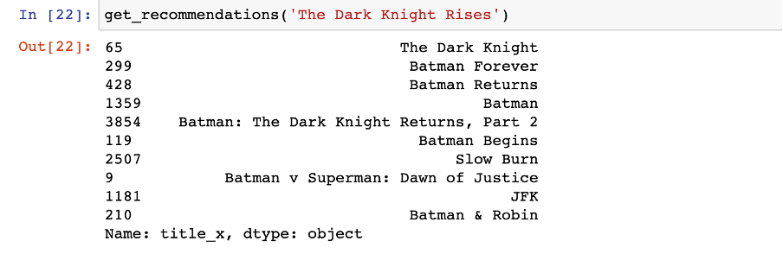
Content based filtering
Plot description-based Recommender
I defined a function that takes a movie title as an input and outputs a list of the ten most similar movies.
An example of the output of the function is below:

Slide 9
Content-based filtering
Credits, Genres and Keywords-Based Recommender
The previous recommendation system, based on plot description, would be improved if there were better metadata. Therefore, I built a recommendation system based on the following metadata: the director, related genres, actors and movie plot keywords. Therefore, developing a credit, genres, and keywords-based recommender was the better option .
An example of the output of the function is below:

Slide 10
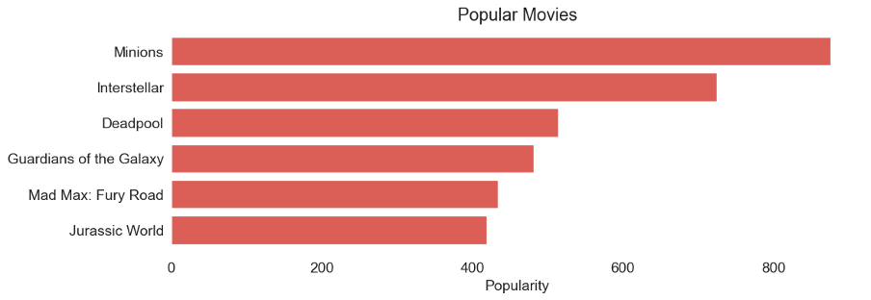
Demographic Filtering
I defined a function called weighted_rating() and defined a new feature score, which calculates the value by applying this function to the data frame of qualified movies.
After further processing, I was able to create a plot of the most popular movies as below:

Slide 11

Recommendations
Demographic recommenders provide a general chart of recommended movies to all the users, and they are not sensitive to the interests and tastes of a particular user. Therefore, a more intuitive system, like Content-based filtering, would be much better with the use of cosine similarity to calculate a numeric quantity that denotes the similarity between two movies.

Slide 12
Further Research
I would love to create a collaborative filtering-based recommendation engine, as I could have explored machine learning models for such a recommendation engine. Still, due to the limitations of my dataset that did not contain a UserID I could not have created one. Exploring and building a collaborative filtering-based recommendation system would be another project I would love to focus on next.

Slide 13


Thank You
Any Questions?

